Slide 1
Lesson 2
Notes:
13:00–13:15 recap of Lesson 1 13:15–14:00 story/intuitive logic: what does “similar” mean? 14:00–14:45 Hamming distance, OM, substitutions/indels 14:45–15:00 break 15:00–15:25 cost choices and sensitivity 15:25–16:35 R lab: compute and compare distances 16:35–17:00 interpretation exercise + wrap-up

Slide 2
Measuring similarity between trajectories
Last week, we learnt to make trajectories visible
This week, we would like to see how similar/different these trajectories are.

Slide 3
Where we are in the course
build → describe → compare → cluster → interpret
Lesson 1: build and describe
Lesson 2: distances and OM
Lesson 3: clustering and typologies
Lesson 4: interpretation, mini-projects, presentations

Slide 4
Recap of the previous episode
Individual pathways
Who follows which trajectory?
Group composition over time
What share is in each state?
Descriptive indicators
Time in states, transitions, complexity
However, visual description is rarely enough if we want to group similar trajectories.

Slide 5
Today’s question: when are two lives close?
EMPLOYED
UNEMPLOYED
Pair A
Pair B
Pair C
Question:
Which pair is most similar? Which pair is most different?
Notes:
Which pair is most similar? Which pair is most different?

Slide 6
Same states, different order
A
B
C
Question: All have 4 periods employed and 4 unemployed. Are they similar?
Same duration in states
Different timing
Different order
Different instability
Duration alone does not define similarity.

Slide 7
Similarity depends on the research question
If your question is about… | You may value…
Exact timing | same state at same age/time
Overall pattern | similar order, even if shifted
Accumulated exposure | time spent in states
Instability | number of transitions
Social mobility | direction of movement
Choose your distance measure carefully, because it is not neutral.
It translates how you want to compare sequences

Slide 8
The logic of sequence dissimilarity

Slide 9
From visual comparison to numeric comparison
A
B
How similar/different are they?
In SAn universe, we ask ”how distant are these sequences”
A distance is a number describing how different two sequences are.
Small distance = similar trajectories.
Large distance = dissimilar trajectories
Notes:
Like measuring distance on a map, but here the map is made of life histories

Slide 10
What is a distance matrix?
 | Anna | Ben | Clara | Daniel
Anna | 0 | 2 | 5 | 4
Ben | 2 | 0 | 4 | 3
Clara | 5 | 4 | 0 | 1
Daniel | 4 | 3 | 1 | 0
The distance matrix is the raw material for clustering.
Diagonal = 0 because each person is identical to themselves.
Matrix is symmetric.
Each cell compares two people.

Slide 11
Comparing one sequence to another
Anna
Ben
First step: We compare two full trajectories.
Second step: We ask how much work is needed to make them identical.
Different methods define “work” differently.
Notes:
how many changes are needed to transform one sequence into another.

Slide 12
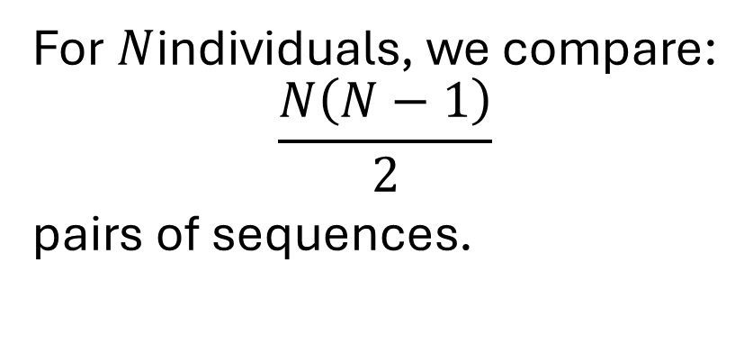
Comparing every sequence to every other sequence
N=5
For $N$individuals, we compare:
$$\frac{N\left(N−1\right)}{2}$$
pairs of sequences.
Example:
5 people = 10 comparisons
10 people = 45 comparisons
1,000 people = 499,500 comparisons

Slide 13
Why distances matter: they are a bridge to clustering
We do not cluster raw sequences directly.
We first decide how to measure similarity.
Then clustering uses the distance matrix.
If the distance measure changes, the clusters may change.
Sequences → Distance matrix → Clusters → Typology

Slide 14
Hamming distance: comparing position by position

Slide 15
First method: compare each time point
Anna
Ben
Hamming distance compares states position by position.
= | = | ≠ | = | ≠ | =

Slide 16
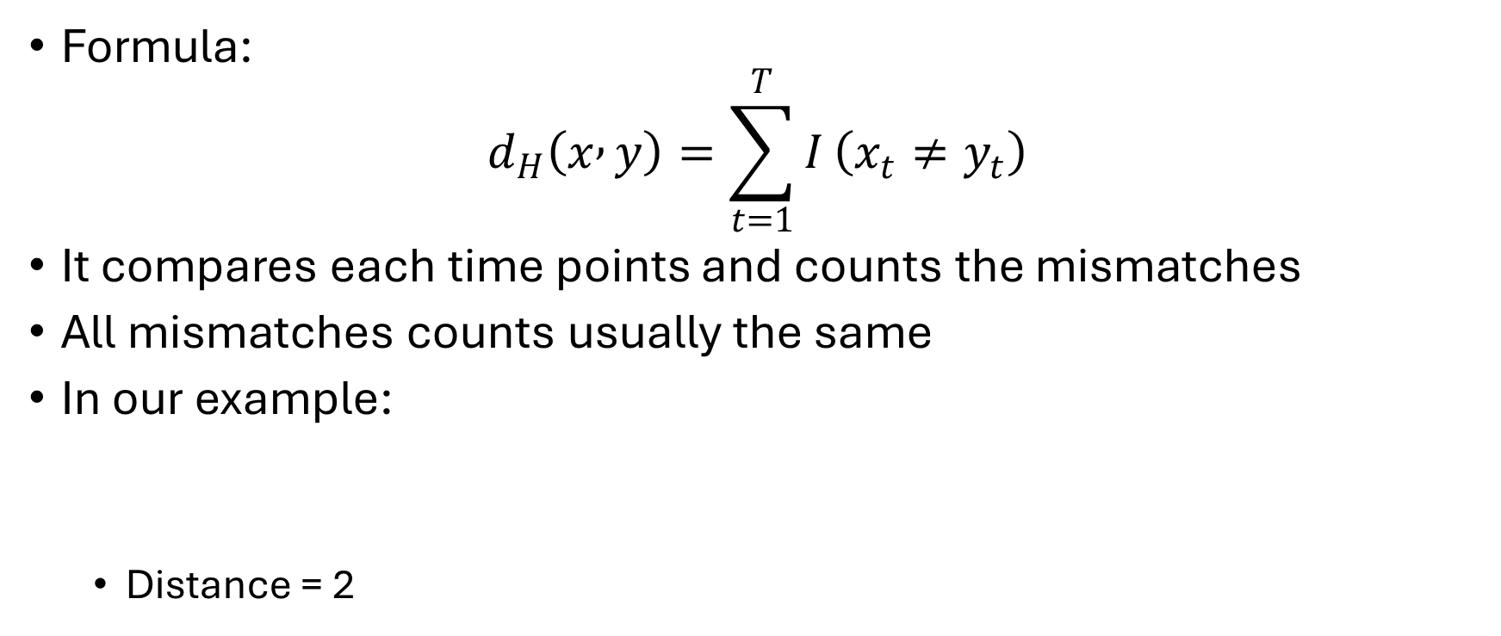
Hamming distance: simple but strict
Formula:
$$d_{H}\left(x , y\right)=\sum_{t=1}^{T}{I}\left(x_{t}≠y_{t}\right)$$
It compares each time points and counts the mismatches
All mismatches counts usually the same
In our example:
Distance = 2

Slide 17
Example: same pattern, shifted in time
Example from Vanhoutte et al. (2018)
A:
B:
Distance = 6 if every substitution costs 1.
A | B | C | A | B | C
C | A | B | C | A | B
≠ | ≠ | ≠ | ≠ | ≠ | ≠

Slide 18
Example: same pattern, shifted in time
Example from Vanhoutte et al. (2018)
A:
B:
Distance = 6 if every substitution costs 1.
Pattern is the same, only shifted!
A | B | C | A | B | C
C | A | B | C | A | B
≠ | ≠ | ≠ | ≠ | ≠ | ≠
A | B | C | A | B
A | B | C | A | B

Slide 19
When Hamming distance is useful
When you work with calendar year:
Anne
Ben
Hammer is most useful when
2015
2016
2017
2018
2019
2020
Timing is central;
Sequences are already aligned meaningfully;
Being in a state at the same time matters.
Notes:
Examples: employment during an economic recession; health state before and after a policy change; school status at exact ages.
Use Hamming when “same state at same time” is substantively important.

Slide 20
When Hamming distance is too rigid
Anna
Ben
Two similar employment trajectories, with one delayed by a year
Problem
Hamming treats delayed but similar pathways as quite different.
It does not easily recognise “same sequence, shifted later.”

Slide 21
Optimal matching

Slide 22
OM: transforming one sequence into another
Sequence A → edit operations → Sequence B
as easy as possible
What is the cheapest way to transform one sequence into another?
You can use three types of operations
Substitution
Insertion
Deletion

Slide 23
Three operations
Substitution
Insertion
Deletion
E | E | U
E | E | U
E | E | P | U
E | E | P
E | E | P | U
E | E | U
Notes:
Substitution changes a state.
Insertion/deletion shifts alignment.
Insertion and deletion are often grouped as indel operations.

Slide 24
Substitution costs: how different are two states?
Example of a cost matrix
Some substitutions are more costly than others
Perhaps employment and part-time are closer than employment and unemployment
Replace… | E | P | U | I
E employment | 0 | 1 | 2 | 2
P part-time | 1 | 0 | 2 | 2
U unemployment | 2 | 2 | 0 | 1
I inactivity | 2 | 2 | 1 | 0
Notes:
Maybe employment and part-time work are close. Maybe employment and unemployment are more different. These choices should follow theory.

Slide 25
Indel costs: how much do we allow shifting?
Low indel cost
High indel cost
If pattern matters more
If timing matters more
Indel costs decide how forgiving we are about timing differences.
Example:
Low indel cost makes it cheap to shift states.
High indel cost makes shifting expensive.
This affects whether delayed but similar sequences look close.

Slide 26
Worked example with coloured tiles
A:
W | W | W | W | W | h | h | h | h | h | w | w | w | w | w
B:
W | W | W | h | h | h | h | h | w | w | w | w | w | w | w
Distance is different according to the method chosen:
Method | Distance
Hamming | 4
OM / Levenshtein | 2
Notes:
Hamming sees mismatches at exact ages. OM sees similar pattern shifted earlier/later.

Slide 27
OM vs. Hamming
Question | Better logic
Do people occupy the same state at the same age/year? | Hamming
Do people follow similar pathways, even if shifted? | OM
Is early versus late timing central? | Hamming or high indel OM
Is order more important than exact age? | OM
Hamming: Are states equal at the same time?
OM: Can one trajectory be « edited » into the other cheaply?

Slide 28
Cost choices are research choices

Slide 29
There is no neutral cost setting
Anna
Ben
Pattern matters more
Balanced setting
Timing matters more
OM with low indel cost
Substitution cost = 2
Indel cost = 0.5
Distance = 1
The cheapest transformation is
delete one E at the beginning: cost 0.5;
insert one E at the end: cost 0.5.
Total = 1 (0.5 + 0.5)
Notes:
Shifting the unemployment spell is cheap. The two sequences are considered very similar.

Slide 30
There is no neutral cost setting
Anna
Ben
Pattern matters more
Balanced setting
Timing matters more
OM with standard indel cost
Substitution cost = 2
Indel cost = 1
Distance = 2
The same deletion and insertion now cost: 1 +1 = 2
Notes:
Timing differences matter, but a shifted common pattern is still recognised.

Slide 31
There is no neutral cost setting
Anna
Ben
Pattern matters more
Balanced setting
Timing matters more
OM with high indel cost
Substitution cost = 2
Indel cost = 3
Distance = 4
Shifting the pattern would cost: 3+3=6
The algorithm instead substitutes the two mismatched positions: 2+2=4
Notes:
Shifting is expensive. The method gives more importance to occupying the same state at the same time.

Slide 32
There is no neutral cost setting
Anna
Ben
The data have not changed. What changed is our definition of similarity.
The distance changes even when:
the two sequences remain identical;
the substitution costs remain identical;
the distance method remains Optimal Matching.
The only change is how costly it is to shift the alignment.
Notes:
Shifting is expensive. The method gives more importance to occupying the same state at the same time.

Slide 33
Theory-driven costs: some states are close than others
Example: labour-market states
Theory-driven costs are useful when the states have a meaningful substantive ordering or proximity.
Do not invent complex costs if you cannot justify them simply
States | Possible interpretation
Full-time vs part-time | Similar labour-market attachment
Employment vs unemployment | Stronger difference
Unemployment vs inactivity | Depends on theory
Education vs employment | Depends on age/life stage

Slide 34
Data-driven costs: transition-rate-based costs
Studer and Ritschard (2016)
State A
Frequent transition between A and B → lower substitution cost
Rare transition between A and B → higher substitution cost
State B
Data-driven costs use observed transitions to decide which states are empirically close.
Data-driven does not mean theoretically neutral. It reflects the structure of this dataset.
Notes:
Example:
If many people move between part-time and full-time work, these states may be treated as close.
If few people move between education and retirement, these states may be treated as distant.

Slide 35
Sensitivity analysis: do conclusions change?
Conducting sensitivity analyses is important to see how your methodological choices can affect your results. For example:
Comparison | Possible finding | Interpretation
Main OM vs low-indel OM | Very similar clusters | Results do not depend strongly on exact timing
Main OM vs transition-rate OM | Same broad groups, some membership changes | State-proximity assumptions matter moderately
Main OM vs Hamming | More early/late distinctions appear | Exact timing strongly influences the typology
Are the distance matrices similar?
Do pairs that are close under one specification remain close under another?
Do the same broad clusters appear?
Are the main trajectory patterns still recognisable?
Do many people change clusters?
Is cluster membership stable?
Do the substantive conclusions change?
Are the same social groups associated with the same trajectories or outcomes?
Notes:
Sensitivity analysis does not require every result to be identical.
The question is: Are the central substantive conclusions robust, and can we explain the differences that appear?
A useful result might be: “The broad distinction between stable and unstable employment histories was robust, but the separation between early and late unemployment depended on the distance measure.”
For example, imagine the main OM analysis identifies:
* stable employment;
* early unemployment followed by employment;
* late employment disruption;
* unstable employment.
Under Hamming distance, “early unemployment” and “late unemployment” may become more clearly separated because Hamming strongly values the exact position of unemployment. Under low-indel OM, these two pathways may instead be treated as variants of the same general pattern.

Slide 36
How to report distance choices transparently?
A suggestion of a reporting checklist
sequence alphabet
time axis and unit
distance measure
substitution costs
indel costs
whether costs are constant, theory-driven or data-driven
sensitivity checks
justification in relation to the research question.

Slide 37
Alternatives and transitions to next lesson

Slide 38
Other distance measures: a brief overview
Measure | Main idea behind the measure
Hamming | Same state at same time
Dynamic Hamming | Timing-specific substitution costs
OM | Edit one sequence into another
LCS | Longest common subsequence
Spell-based distances | Spell structure and duration
Distance from ideal types | Compare to predefined reference trajectories
Notes:
There is no single best distance. There are better or worse matches between distance and question.

Slide 39
Choosing a distance based on the question
Do I care about exact timing
Yes: Hamming / dynamic Hamming / high indel OM
Do I care about similar order even if shifted?
Yes: OM / LCS
Do I care about distance from a normative pathway?
Yes: Distance from ideal type
Do I care about spells and duration?
Yes: Spell-sensitive measures
Notes:
Start from the research question, not from the default command.

Slide 40
From distances to typologies: sneak peak of lesson 3
Distance matrix → hierarchical clustering → groups of trajectories
Next week:
Use the distance matrix
Run hierarchical clustering
Read a dendrogram
Choose number of clusters;
Interpret typologies;

Slide 41
References
Abbott 1995; Abbott & Tsay 2000; Aisenbrey & Fasang 2010; Studer & Ritschard 2016; Gabadinho et al. 2011; Vanhoutte, Wahrendorf & Prattley 2018.

Slide 42
Exercise time

Slide 43
Today’s missiong – guided part
Start with two toy sequences
Calculate Hamming distance
Calculate Optimal Matching distance
Change indel costs
Compute distance matrices for the full dataset
Compare OM, Hamming and transition-rate costs
Save distance matrices for Lesson 3
Main question: What does it mean for two trajectories to be close?
Functions:
seqdist()
seqsubm()
seqcost()

Slide 44
Mini project
Today you work on Section 3.2 of your report
Targeted report section: Dissimilarity measure and justification
Step 1: Recreate your sequence object
Use your own domain from Lesson 1.
Step 2: Compute at least two distance matrices
For example: OM with constant costs, Hamming, OM with transition-rate costs, OM with a different indel cost
Step 3: Compare them
Do the same people look similar?
Does one measure emphasise timing more?
Which measure fits my question best?
Step 4: Save your main distance matrix
You will need it for clustering in Lesson 3.
Before leaving today, write down:
My main distance measure is...
I chose it because my research question focuses on...
My substitution-cost strategy is...
My indel cost is...
One sensitivity check I will use is...

